Slide 1
Parmonic Interview quetsions

Slide 2
Q3)DDD for Single Entry Ledger
Customer
Sell Product
Buy Product
Credit
Debit
Update Balance Sheet
Check Balance

Slide 3

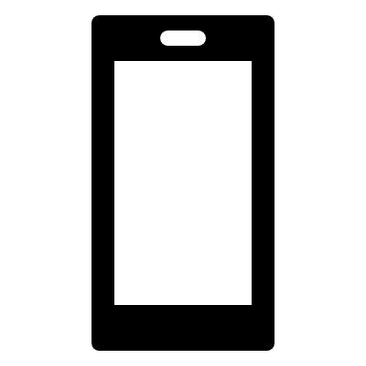
Q4)Design Microservice For Single Entry Ledger
Rest Api
Purchased Product(Credit)
Get(){Parameter : carddetails}
Api GateWay
Rest Api
Update Balance
Post(){parameter:carddetails,customerdetails,debit/credit}
Sold Product(Debit)
Rest Api
Get(){Parameter:Customer carddetails}
View Balance
Rest Api
Get(Carddetails)
{Returns Current Balance amount}
Notification
Rest Api

